Slide 1
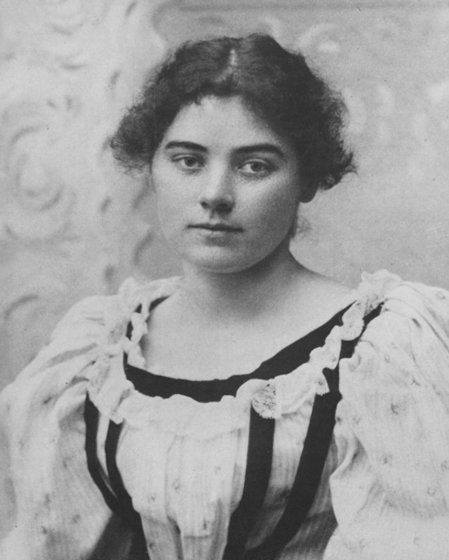
EMDialog
Emily Carr
Zi Wang (Max)

Slide 2
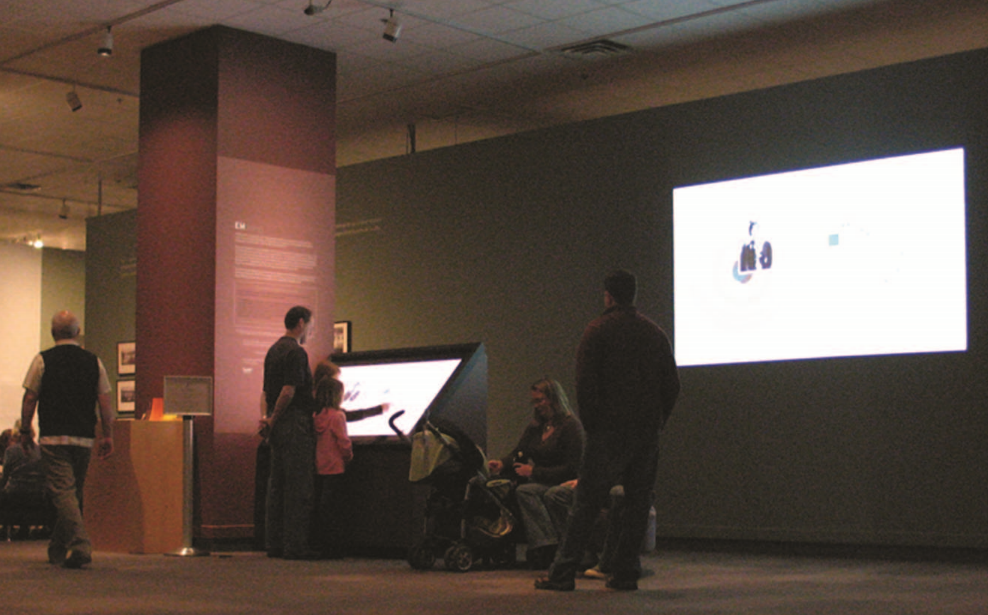

Slide 5
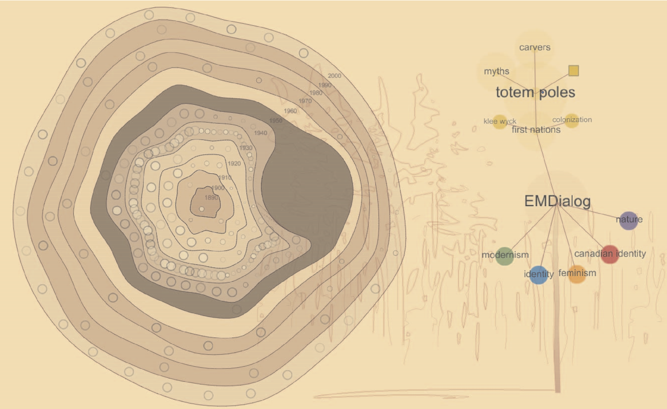

Slide 6
The End
Thank You

