Slide 1
Integration of Measurement Tools in Medical 3d Visualizations
By Jared O’Donnell

Slide 2
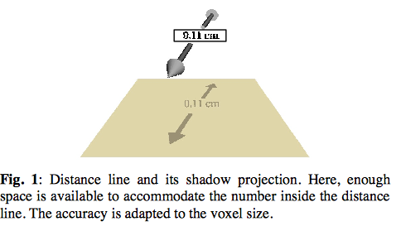

Slide 3
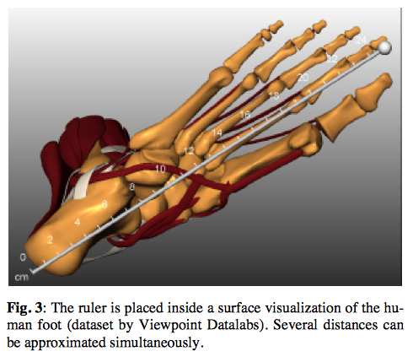

Slide 4
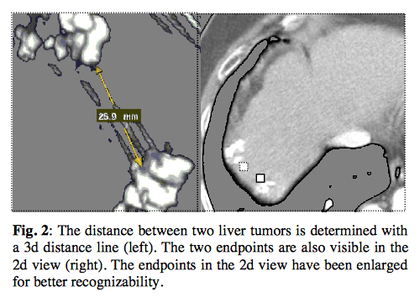

Slide 5
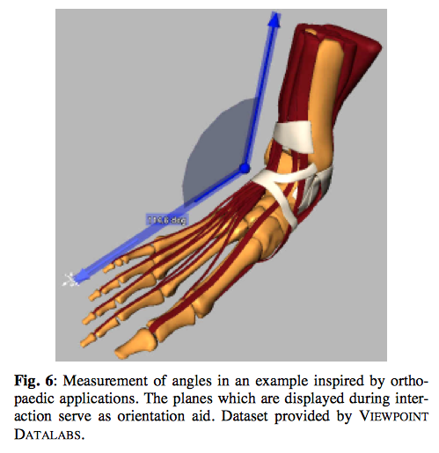

Slide 6
