Slide 1
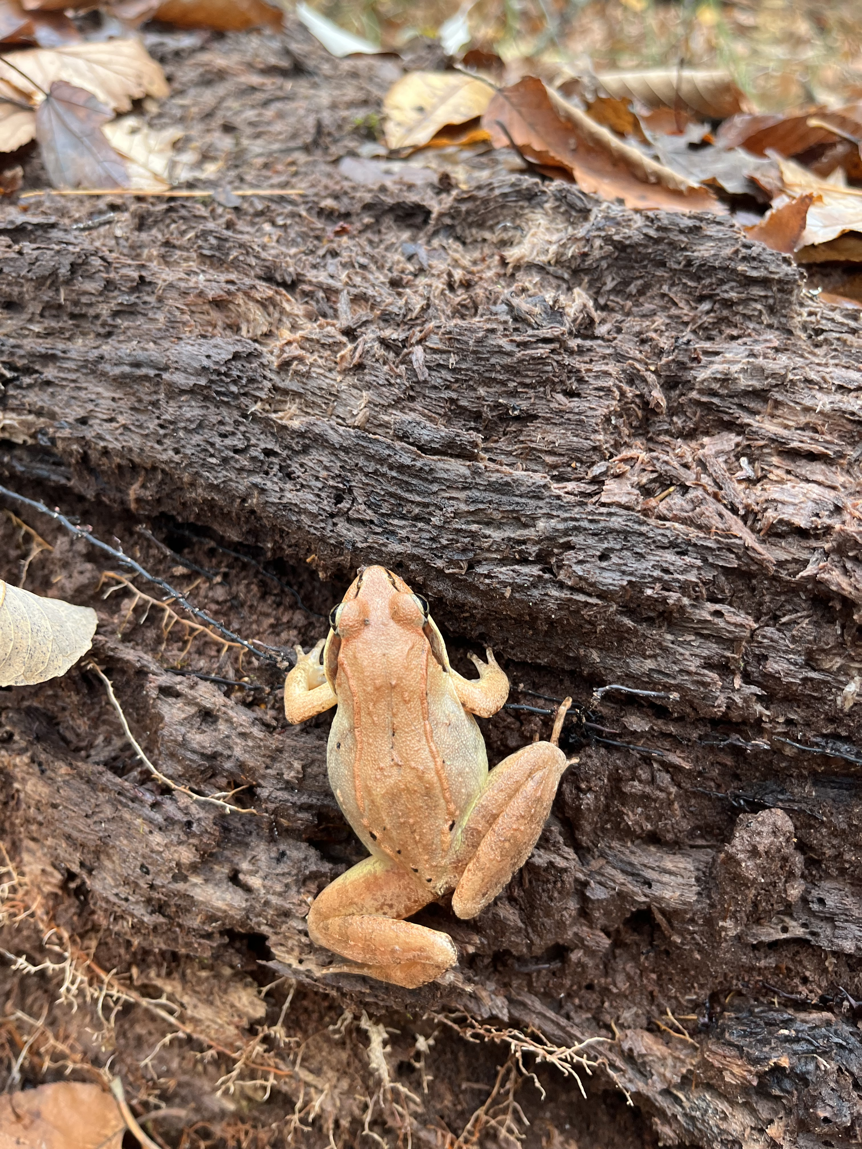
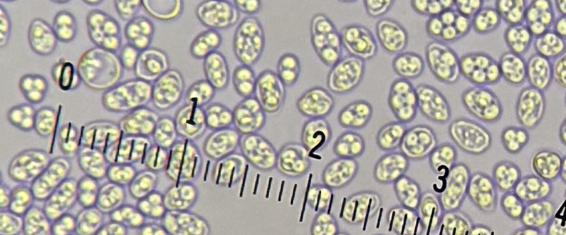
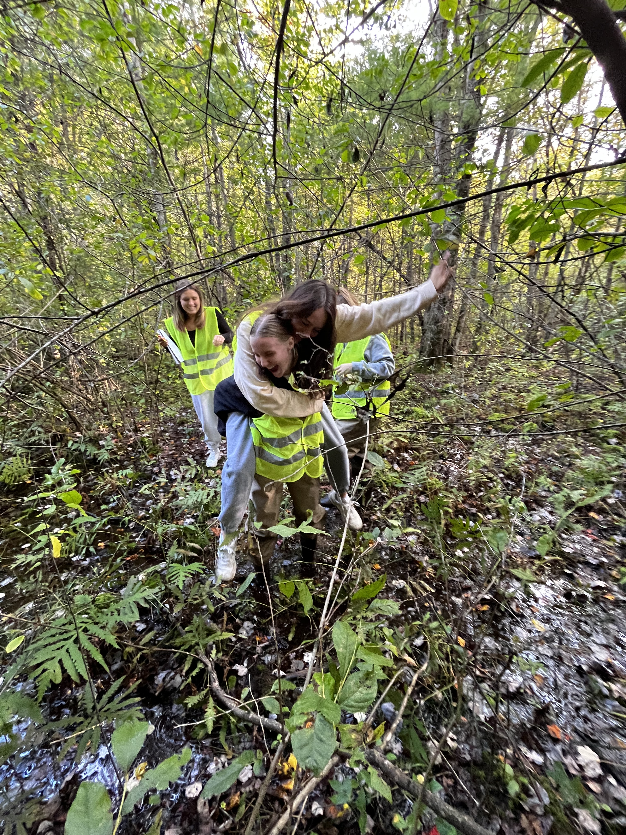
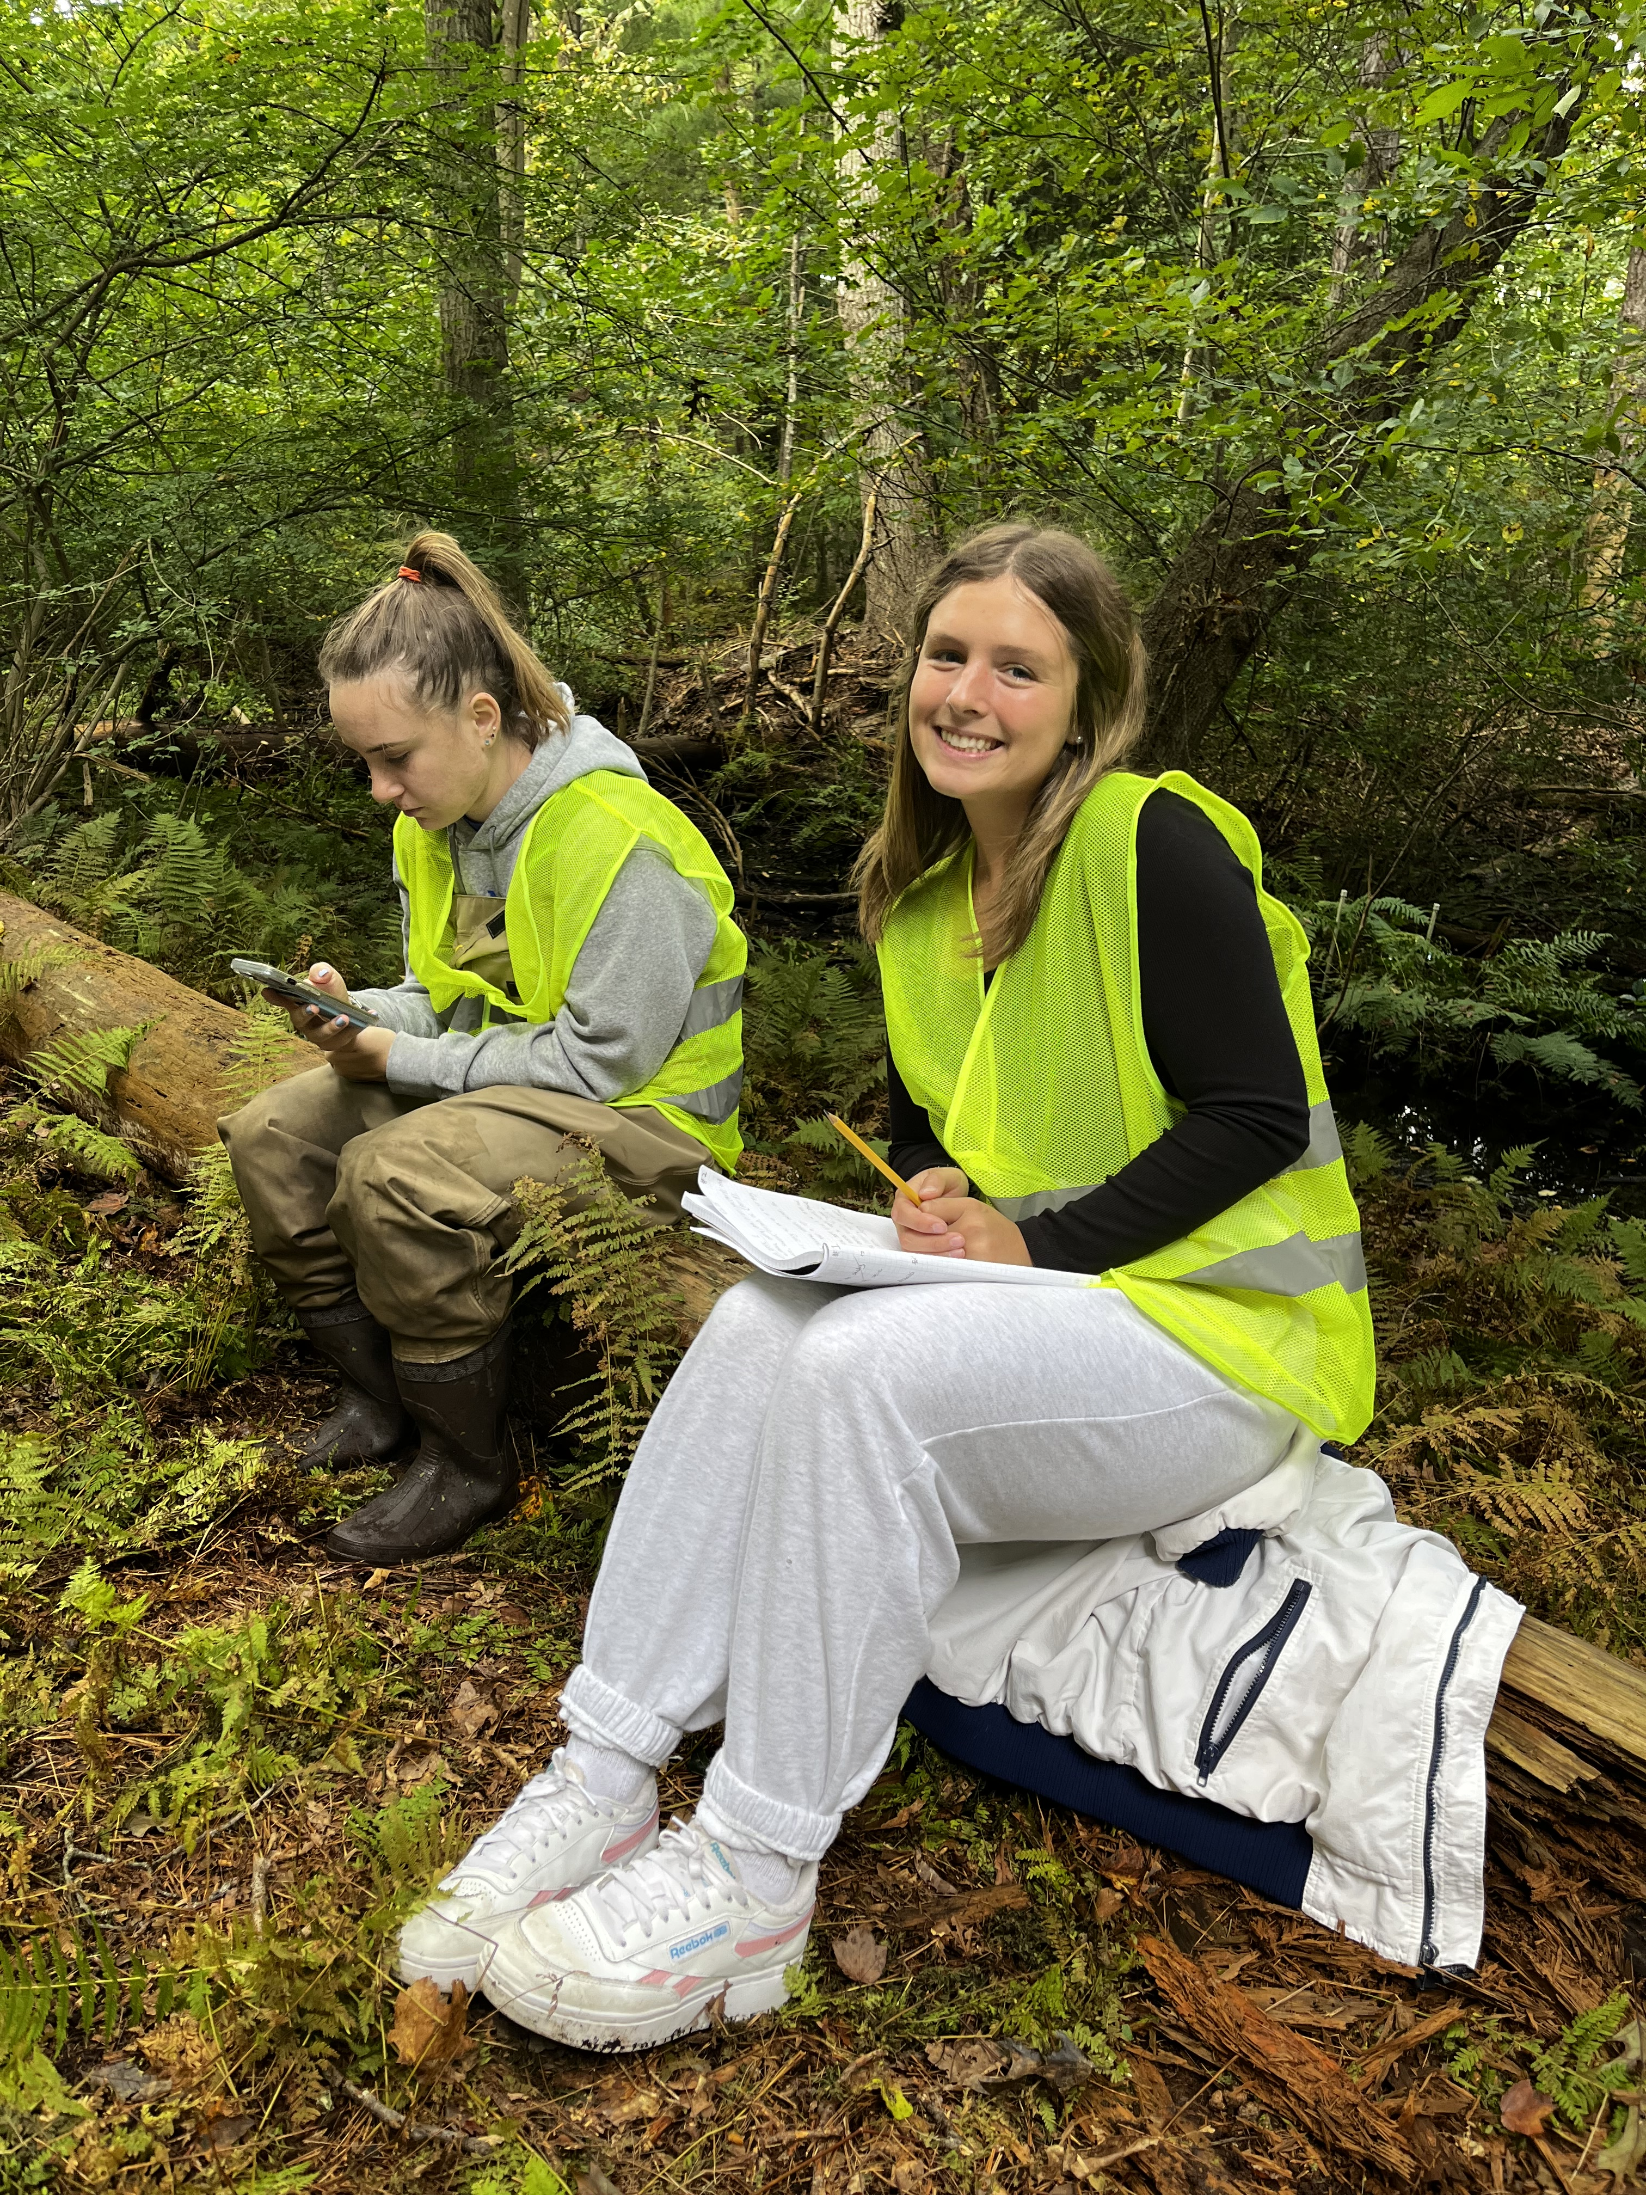
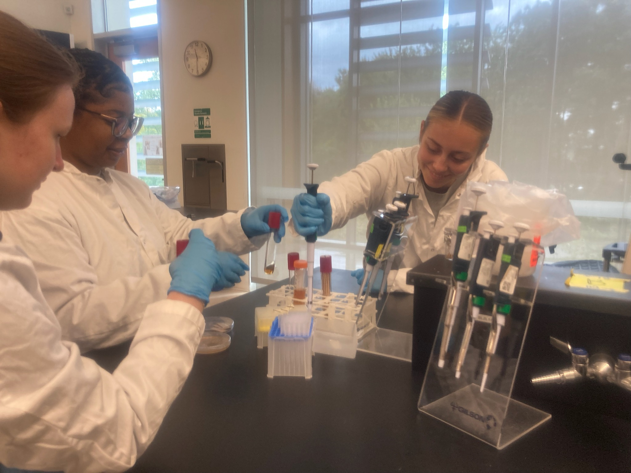
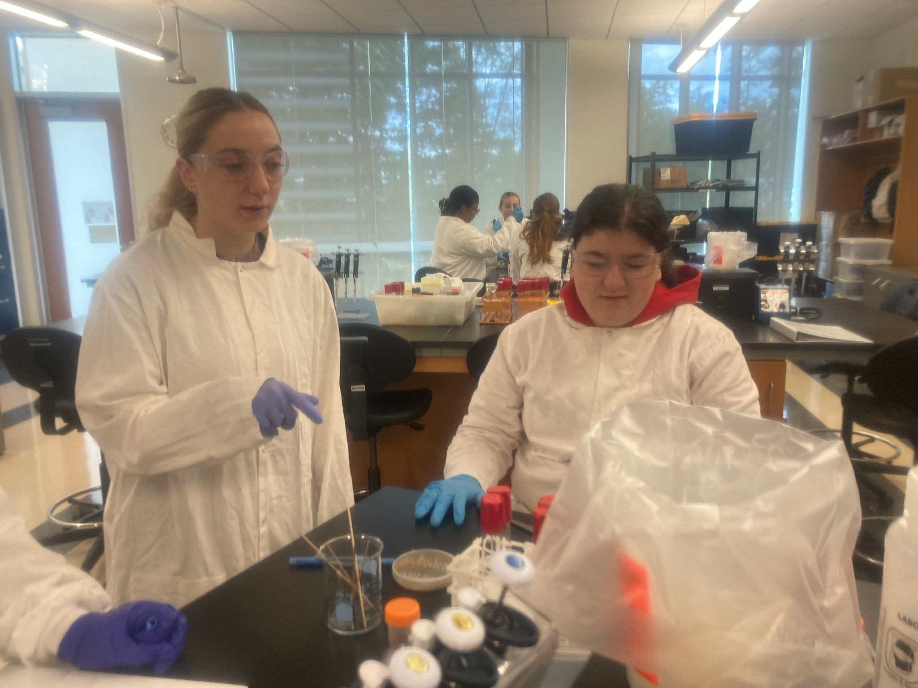

RESEARCH EXPERIENCE IN BIOLOGY
STUDENT POSTER SESSION
DETAILS:
TUESDAY DECEMBER 3
11 AM-12:20 PM & 2-3:30 PM
DIANA DAVIS SPENCER CAFÉ

