Slide 1
Impacts of Moore’s Law: What every CIS undergraduate should know about the impacts of advancing technology
Mary Jane Irwin
Computer Science & Engr.
Penn State University
April 2007

Slide 2
Or: Are computers getting faster??
Mike Gousie
Dept. of Math & Comp. Science
Wheaton College
Spring 2017

Slide 3
Read me
This talk was created for and given at the CCSCNE conference held in Rochester, NY on April 20 and 21.
You are welcome to download a copy of these slides and use them in your classes. Just be sure to leave the credits on individual slides (e.g., Courtesy, Intel ® )
If you are like me, you never just give someone else’s presentation unchanged. I expect you to add your own intellectual content. That is why I make ppt available (not pdf) – just so you can customize it for your needs. But I do ask that you give me credit for the source material somehow (like on the title slide).
April 2007, Irwin, PSU

Slide 4
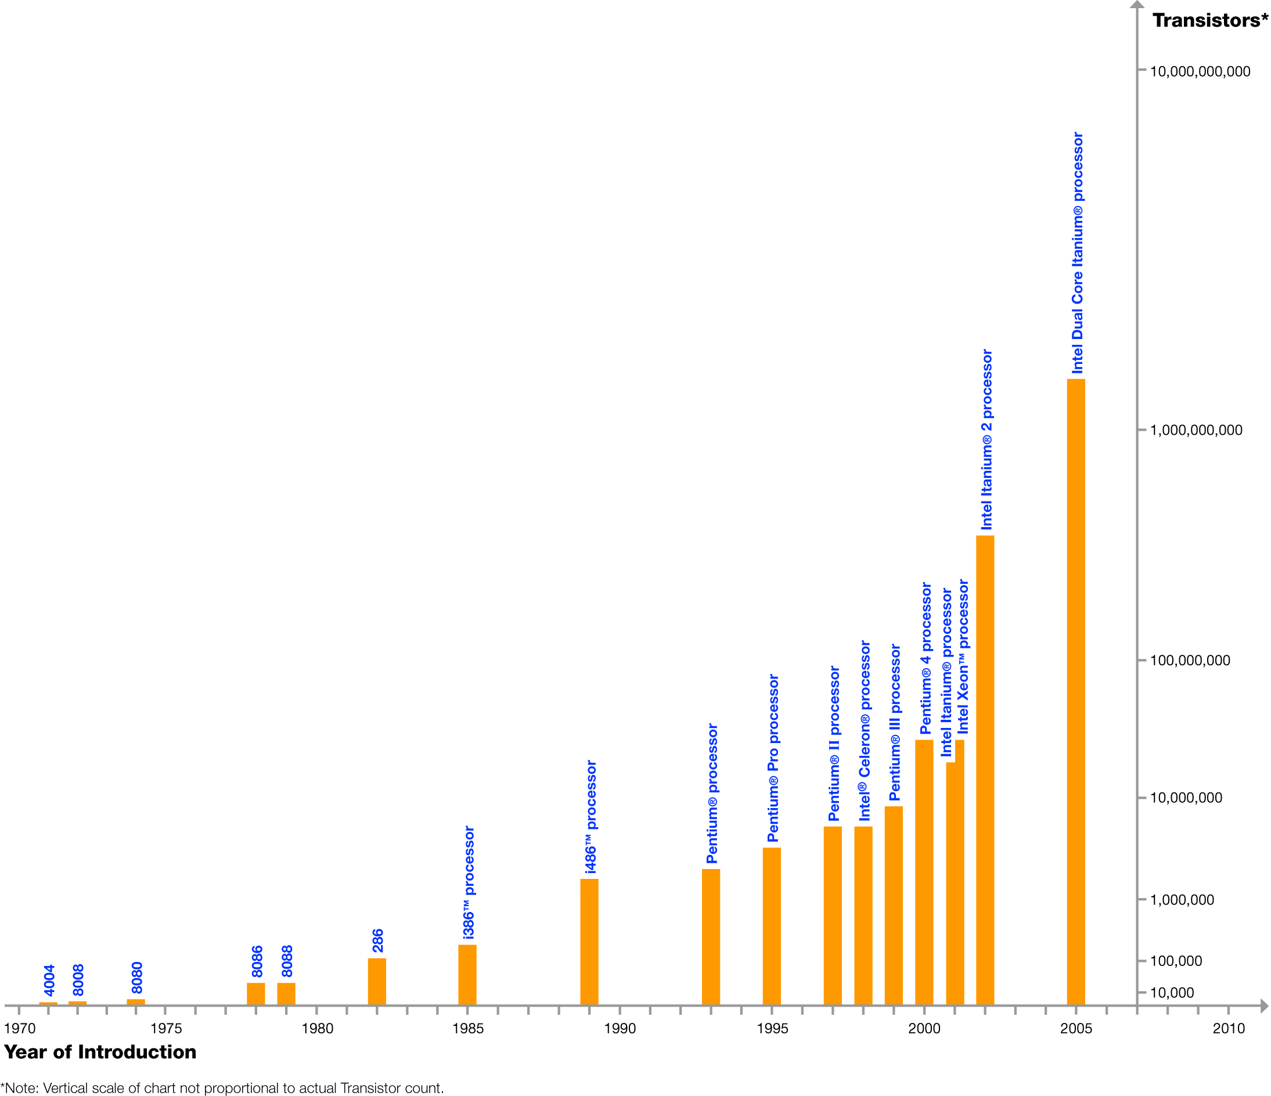
Moore’s Law
In 1965, Intel’s Gordon Moore predicted that the number of transistors that can be integrated on single chip would double about every two years
Dual Core Itanium with 1.7B transistors
feature size
&
die size
April 2007, Irwin, PSU
Courtesy, Intel ®

Slide 5
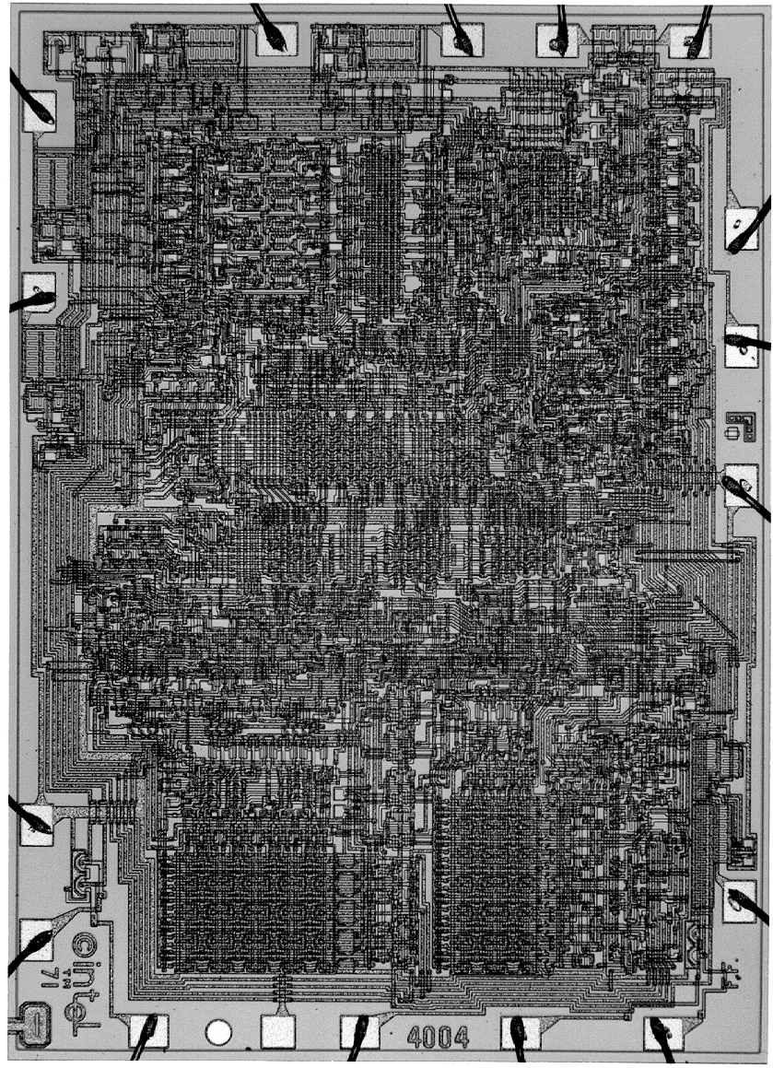
Intel 4004 Microprocessor
1971
0.2 MHz clock
12 mm² die
10,000 nm feature size
~2,300 transistors
2mW power
April 2007, Irwin, PSU
Courtesy, Intel ®
Notes:
<number>
introduced in 1971 versus 8086 introduced in 1978
1 MHz clock rate 10 MHz clock rate
5volt VDD (?) 5volt VDD
10 micron (?) 3 micron
5K transistors (?) 29K transistors

Slide 6
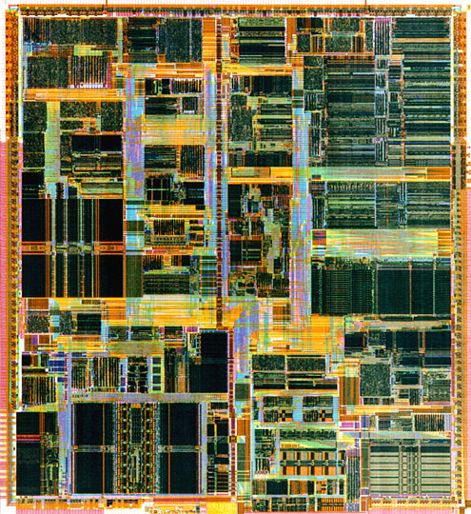
Intel Pentium (IV) Microprocessor
2001
1.7 GHz clock
271 mm² die
180 nm feature size
~42M transistors
64W power
30 (15*2) years
8500x faster
20x bigger die
55x smaller feature size
18,000x more T’s
32,000x (2¹⁵) more power
April 2007, Irwin, PSU
Courtesy, Intel ®
Notes:
<number>
P5 introduced in 1994 versus P6 (Pentium Pro) in 1996
75 to 100 MHz clock rate 150 to 200 MHz clock rate
91 mm**2 196 mm**2
3.3M transistors 5.5M transistors
(1M in cache) (external cache)
0.35 micron 0.35 micron
4 layers metal 4 layers metal
3.3volt VDD 3.3volt VDD
>20W typical power dissipation
387 pins

Slide 7
Intel Pentium (IV) Microprocessor
2001
1.7 GHz clock
271 mm² die
180 nm feature size
~42M transistors
64W power
This means 2^15 increase = 32.768x
8500x faster
20x bigger die
55x smaller feature size
18,000x more T’s
32,000x (2¹⁵) more power
April 2007, Irwin, PSU
Courtesy, Intel ®
Notes:
<number>
P5 introduced in 1994 versus P6 (Pentium Pro) in 1996
75 to 100 MHz clock rate 150 to 200 MHz clock rate
91 mm**2 196 mm**2
3.3M transistors 5.5M transistors
(1M in cache) (external cache)
0.35 micron 0.35 micron
4 layers metal 4 layers metal
3.3volt VDD 3.3volt VDD
>20W typical power dissipation
387 pins

Slide 8
Technology scaling road map (Intel chips)
 | 2004 | 2006 | 2008 | 2010 | 2012 | 2014 | 2016
Feature size (nm) | 130 | 90 | 45 | 32 | 22 | 22 | 14
Integrative Capacity (billions of transistors) | 0.6 | 1.7 | 1.9 | 1.2 | 5 | 5.6 | 30
Fun facts about 45nm transistors
  30 million can fit on the head of a pin
  You could fit more than 2,000 across the width of a human hair
  If car prices had fallen at the same rate as the price of a single transistor has since 1968, a new car today would cost about 1 cent
April 2007, Irwin, PSU
Notes:
<number>
International Technology Roadmap for Semiconductors

Slide 9
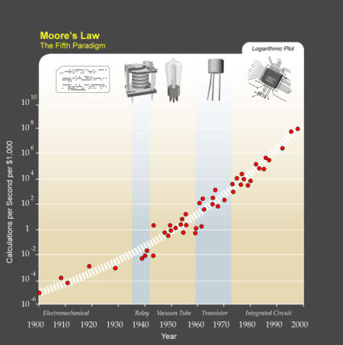
Kurzweil “expansion” of Moore's Law
Processor clock rates have also been doubling about every two years
April 2007, Irwin, PSU

Slide 10
Technology scaling road map – Take 2
 | 2004 | 2006 | 2008 | 2010 | 2012 | 2014 | 2016
Feature size (nm) | 130 | 90 | 45 | 32 | 22 | 22 | 14
Integrative Capacity (billions of transistors) | 0.6 | 1.7 | 1.9 | 1.2 | 5 | 5.6 | 30
Delay Scaling | 0.7 | ~0.7 | >0.7 | Delay Scaling has slowed down
Delay Scaling will slow down
More fun facts about 45nm transistors
  It can switch on and off about 300 billion times a second
  A beam of light travels less than a tenth of an inch during the time it takes a 45nm transistor to switch on and off
April 2007, Irwin, PSU

Slide 11
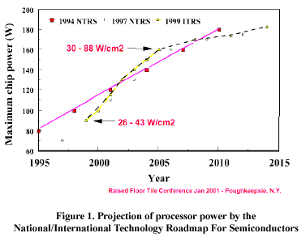
Too much heat!
Between 2000 and 2005, chip power increased by 1.6x
Heat flux by 2x
  ∝ power/area
 | Light Bulb 100 W | BGA Pack 25W
Surface Area | 106 cm² | 1.96 cm²
Heat Flux | 0.9 W/cm² | 12.75 W/cm²
Main culprits
  Increasing clock frequencies
    Power (Watts) = V² f + V I_{off}
  Technology scaling
    Leaky transistors
April 2007, Irwin, PSU

Slide 12
Too much power consumption!
Impacts battery life for mobile devices
Impacts the cost of powering & cooling servers
Spending (B of $)
April 2007, Irwin, PSU
Source: IDC
Notes:
<number>
Five largest search companies now use about 2 million servers, which consume about 2.4 gigawatts of power. By comparison, Hoover Dam generates a maximum of about 2 gigawatts.

Slide 13
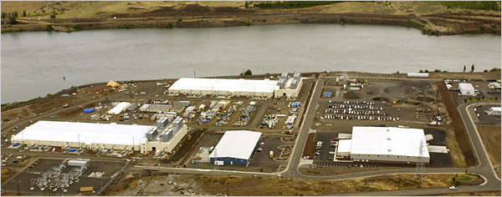
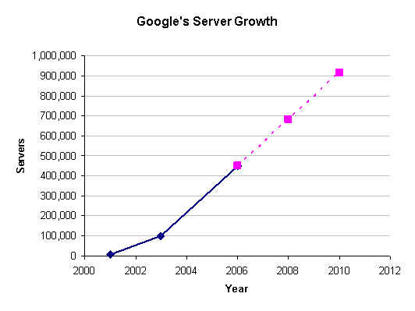

Google’s “solution”
April 2007, Irwin, PSU

Slide 14
Technology scaling road map – Take 3
 | 2004 | 2006 | 2008 | 2010 | 2012 | 2014 | 2016
Feature size (nm) | 130 | 90 | 45 | 32 | 22 | 22 | 14
Integrative Capacity | 0.6 | 1.7 | 1.9 | 1.2 | 5 | 5.6 | 30
Delay Scaling | 0.7 | ~0.7 | >0.7 | Delay Scaling has slowed down
Energy Scaling | ~0.35 | ~0.5 | >0.5 | Energy Scaling has slowed down
A 60% decrease in feature size increases the heat flux (W/cm²) by six times
April 2007, Irwin, PSU

Slide 15

A sea change is at hand …
November 14, 2004 headline
  “Intel kills plans for 4 GHz Pentium”
Why ?
  Problems with power consumption (and thermal densities)
  Power consumption ~ supple_voltage² * clock_frequency
So what are we going to do with all those transistors?
April 2007, Irwin, PSU

Slide 16
What to do?
Move away from frequency scaling alone to deliver performance
More on-die memory (e.g., bigger caches, more cache levels on-chip)
More multi-threading (e.g., Sun’s Niagara)
More throughput oriented design (e.g., IBM Cell Broadband Engine)
More cores on one chip
April 2007, Irwin, PSU

Slide 17
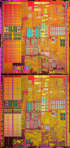
Dual-core chips
In April of 2005, Intel announced the Intel® dual-core processor - two cores on the same chip both running at the same frequency - to balance energy-efficiency and performance
Intel’s (and others) first step into the multicore future
April 2007, Irwin, PSU
Courtesy, Intel ®

Slide 18
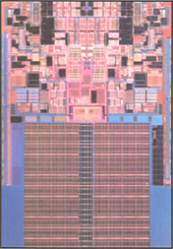
Intel’s 45nm dual core - Penryn
With new processing technology (high-k oxide and metal transistor gates)
  20% improvement in transistor switching speed (or 5x reduction in source-drain leakage)
  30% reduction in switching power
  10x reduction in gate leakage
April 2007, Irwin, PSU
Courtesy, Intel ®

Slide 19
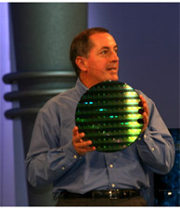
How far can it go?
In September of 2006, Intel® announced a prototype of a processor with 80 cores that can perform a trillion floating-point operations per second
Courtesy, Intel ®
April 2007, Irwin, PSU

Slide 20
A generic multi-core platform
PE
PE
PE
PE
General and special purpose cores (Processor Elements - PEs)
  PEs likely to have the same instruction set architecture (ISA)
Memory
Memory
Memory
Memory
NIC
NIC
NIC
NIC
R
R
R
R
PE
PE
PE
PE
Memory
Memory
Memory
Memory
NIC
NIC
NIC
NIC
R
R
R
R
PE
PE
PE
PE
Memory
Memory
Memory
Memory
Interconnect fabric
  Network on Chip (NoC)
NIC
NIC
NIC
NIC
R
R
R
R
PE
PE
PE
PE
Memory
Memory
Memory
Memory
NIC
NIC
NIC
NIC
R
R
R
R
April 2007, Irwin, PSU
Notes:
<number>

Slide 21
Thursday, September 26, 2006
Fall 2006 Intel Developer Forum (IDF)
<number>
Notes:
<number>

Slide 22
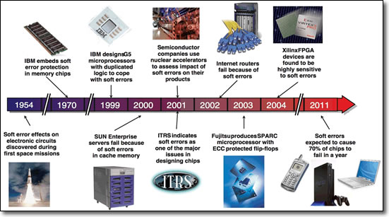
But wait! There's more trouble...
Systems are becoming less, not more, reliable
  Transient soft error upsets (SEU) from high-energy neutron particles from extraterrestrial cosmic rays
  Increasing concerns about technology effects like electromigration (EM), NBTI, TDDB, …
  Increasing process variation
April 2007, Irwin, PSU
Notes:
<number>
NBTI – negative bias temperature instability which significantly shifts threshold voltage and reduces drive current. In CMOS devices, the NBTI-induced threshold voltage shift will occur over a period of months or years, depending on the operating conditions of the device. NBTI recovery can reach 100% at 25°C.
TDDB - Time Dependent Dielectric Breakdown – gate breakdown
Electromigration is exacerbated by high current densities and the Joule heating of the conductor.

Slide 23
Technology scaling road map – Take 4
Year | 2004 | 2006 | 2008 | 2010 | 2012
Feature size (nm) | 90 | 65 | 45 | 32 | 22
Intg. Capacity (BT) | 2 | 4 | 6 | 16 | 32
Delay = CV/I Scaling | 0.7 | ~0.7 | >0.7 | Delay Scaling will slow down
Energy/Logic Op Scaling | >0.35 | >0.5 | >0.5 | Energy Scaling will slow down
Process Variability
Medium High Very High
Transistors in a 90nm part have 30% variation in frequency, 20x variation in leakage
April 2007, Irwin, PSU

Slide 24
Technology scaling road map – Take 4
 | 2004 | 2006 | 2008 | 2010 | 2012 | 2014 | 2016
Feature size (nm) | 130 | 90 | 45 | 32 | 22 | 22 | 14
Integrative Capacity | 0.6 | 1.7 | 1.9 | 1.2 | 5 | 5.6 | 30
Delay Scaling | 0.7 | ~0.7 | >0.7 | Delay Scaling has slowed down
Energy Scaling | ~0.35 | ~0.5 | >0.5 | Energy Scaling has slowed down
Process Variability | Medium | High | Very high
Transistors in a 90nm part have 30% variation in frequency, 20x variation in leakage
April 2007, Irwin, PSU

Slide 25
And … heat flux effects on reliability
AMD recalls faulty Opterons
  running floating point-intensive code sequences
  elevated CPU temperatures, and
  elevated ambient temperatures
could produce incorrect mathematical results when the chips get hot
On-chip interconnect speed is impacted by high temperatures
April 2007, Irwin, PSU

Slide 26

Some multi-core resiliency issues
Thermal emergencies
PE
PE
PE
PE
Memory
Memory
Memory
Memory
NIC
NIC
NIC
NIC
Run away leakage on idle PEs
R
R
R
R
PE
PE
PE
PE
Memory
Memory
Memory
Memory
NIC
NIC
NIC
NIC
Timing errors due to process & temperature variations
R
R
R
R
PE
PE
PE
PE
Memory
Memory
Memory
Memory
NIC
NIC
NIC
NIC
R
R
R
R
Logic errors due to SEUs, NBTI, EM, …
PE
PE
PE
PE
Memory
Memory
Memory
Memory
NIC
NIC
NIC
NIC
R
R
R
R
April 2007, Irwin, PSU
Notes:
<number>

Slide 27

Multi-core sensors and controls
Power/perf/fault “sensors”
  current & temp
  hw counters
  . . .
PE
PE
PE
PE
Memory
Memory
Memory
Memory
NIC
NIC
NIC
NIC
R
R
R
R
PE
PE
PE
PE
Memory
Memory
Memory
Memory
NIC
Power/perf/fault “controls”
  Turn off idle and faulty PEs
NIC
NIC
NIC
R
R
R
R
PE
PE
PE
PE
Memory
Memory
Memory
Memory
NIC
NIC
NIC
NIC
R
R
R
R
  Apply dynamic voltage frequency scaling (DVFS)
  . . .
PE
PE
PE
PE
Memory
Memory
Memory
Memory
NIC
NIC
NIC
NIC
R
R
R
R
April 2007, Irwin, PSU
Notes:
<number>
Other sensors: leakage, faults
Other controls: Vt, fan speed adjustment

Slide 28
Multicore Challenges & Opportunities
Can users actually get at that extra performance?
  “I’m concerned they will just be there and nobody will be driven to take advantage of them,” Douglas Post, head of the DoC’s HPC Modernization Program
Programming them
  “Overhead is a killer. The work to manage that parallelism has to be less than the amount of work we’re trying to do. Some of us in the community have been wrestling with these problems for 25 years. You get the feeling [commodity chip designers] are not even aware of them yet. Boy, are they in for a surprise.” Thomas Sterling, CACR, CalTech
April 2007, Irwin, PSU
Notes:
<number>
The multicore approach will work well when running multiple applications simultaneously, which the operating system can divvy up between multiple cores automatically. So no problem—yet.
But getting multiple cores to run one large application requires concurrent programming, a demanding discipline now practiced by few. Eventually, such skills will be needed not only for HPC programs, but enterprise software in general, observers noted.

Slide 29
Keeping many PEs busy
Can have many applications running at the same time, each one running on a different PE
Or can parallelize application(s) to run on many PEs
summing 1000 numbers on 8 PEs
P0
P1
P2
P3
P4
P5
P6
P7
P0
P1
P2
P3
P0
P1
April 2007, Irwin, PSU
P0

Slide 30
Sample summing pseudo code
A and sum are shared, i and half are private
sum[Pn] = 0;
for (i = 1000*Pn; i< 1000*(Pn+1); i = i + 1)
sum[Pn] = sum[Pn] + A[i];
/* each PE sums its
/* subset of vector A
April 2007, Irwin, PSU

Slide 31
Barrier synchronization pseudo code
arrive (initially unlocked) and depart (initially locked) are shared spin-lock variables
procedure synch()
lock(arrive);
count := count + 1; /* count the PEs as
if count < n /* they arrive at barrier
then unlock(arrive)
else unlock(depart);
lock(depart);
count := count - 1; /* count the PEs as
if count > 0 /* they leave barrier
then unlock(depart)
else unlock(arrive);
April 2007, Irwin, PSU

Slide 32
Power Challenges & Opportunities
DVFS (Dynamic Voltage Frequency Scaling): Run-time system monitoring and control of circuit sensors and knobs
  Big energy (and power) savings on lightly loaded systems
Options when performance is important: Take advantage of PE and NoC load imbalance and/or idleness to save energy with little or no performance loss
  Use DVFS at run-time to reduce PE idle time at synchronization barriers
  Use DVFS at compile time to reduce PE load imbalances
  Shut down idle NoC links at run-time
April 2007, Irwin, PSU

Slide 33
Exploiting PE load imbalance
Use DVFS to reduce PE idle time at barriers
Idle time at barriers (averaged
over all PEs, all iterations)
Loop name | 4 PEs
applu.rhs.34 | 31.4%
applu.rsh.178 | 21.5%
galgel.dswap.4222 | 0.55%
galgel.dger.5067 | 59.3%
galgel.dtrsm.8220 | 2.11%
mgrid.zero3.15 | 33.2%
mgrid.comm3.176 | 33.2%
swim.shalow.116 | 1.21%
swim.calc3z.381 | 2.61%
PE₀
PE₁
PE₂
PE₃
fork
active
time
idle
time
join
barrier
April 2007, Irwin, PSU
Liu, Sivasubramaniam, Kandemir, Irwin, IPDPS’05
Notes:
<number>

Slide 34
Potential energy savings
Using a last value predictor (LVP)
  the idle time of next iteration same as current one
4 PEs
8 PEs
Energy Savings
Better savings with
more PEs
(more load imbalance)!
April 2007, Irwin, PSU

Slide 35
Reliability Challenges & Opportunities
How to allocate PEs & map application threads to handle run-time availability changes?
  while optimizing power and performance
PE
PE
PE
PE
Memory
Memory
Memory
Memory
NIC
NIC
NIC
NIC
R
R
R
R
PE
PE
PE
PE
Memory
Memory
Memory
Memory
NIC
NIC
NIC
NIC
R
R
R
R
PE
PE
PE
PE
Memory
Memory
Memory
Memory
NIC
NIC
NIC
NIC
R
R
R
R
PE
PE
PE
PE
Memory
Memory
Memory
Memory
NIC
NIC
NIC
NIC
R
R
R
R
Program Execution
16 PEs
16 threads
?
2 PEs go down
April 2007, Irwin, PSU
Notes:
<number>
This explains the problem (i.e. availability change) and the goal (Power and Performance).
WMH: What is the level of improvement expected in future many-core chips?

Slide 36
Best energy-delay choices for the FFT
# threads
# PEs
16
(16,16)
Two PEs
go down
(14,14)
(16,14)
14
DVFS
9% reduction
(11,11)
Thread
Migration
Number of PEs
11
Code
Versioning
20% reduction
9
(16,9)
8
40% reduction
8
11
14
16
Number of Threads
April 2007, Irwin, PSU
Yang, Kandemir, Irwin, Interact’07

Slide 37
Architecture Challenges & Opportunities
Memory hierarchy
  NUCA shared L2 banks, one/PE
PE
PE
PE
PE
PE
PE
PE
L1
L1
L1
PE
L1
Memory
Memory
Memory
Memory
L2 bank
L2 bank
L2 bank
L2 bank
NIC
NIC
NIC
NIC
R
R
R
R
PE
Shared data far from all PEs
  Migrate L2 block to requesting PE
    ping pong migration, access latency, energy consumption
  Don’t migrate and pay perf penalty
PE
PE
PE
PE
PE
PE
L1
L1
PE
L1
L1
Memory
Memory
Memory
Memory
L2 bank
L2 bank
L2 bank
L2 bank
NIC
NIC
NIC
NIC
R
R
R
R
PE
PE
PE
PE
PE
PE
PE
L1
L1
L1
PE
L1
Memory
Memory
Memory
Memory
L2 bank
L2 bank
L2 bank
L2 bank
NIC
NIC
NIC
NIC
R
R
R
R
PE
PE
PE
PE
PE
PE
PE
L1
L1
PE
L1
L1
Memory
Memory
Memory
Memory
L2 bank
L2 bank
L2 bank
L2 bank
NIC
NIC
NIC
NIC
R
R
R
R
April 2007, Irwin, PSU
Notes:
<number>
Cache coherency issues (MOESI)

Slide 38
More Multicore Challenges & Opportunities
Off-chip (main) memory bandwidth
Compiler/language support
  automatic (compiler) thread extraction
  guaranteeing sequential consistency
OS/run-time system support
  lightweight thread creation, migration, communication, synchronization
  monitoring PE health and controlling PE/NoC state
Hardware verification and test
High performance, accurate simulation/emulation tools
April 2007, Irwin, PSU
Notes:
<number>
It can be expected that such heterogeneous multicore systems will employ a range of operating systems, from applications to real-time OSes, across multiple cores, and therefore will have resources that cannot be managed by any single operating system. This situation is exacerbated further by the presence of hardware accelerators which do not run any form of operating system, but which must interact with processes that are potentially running on multiple operating systems on different cores.

Slide 39
What about sequential processes?
Multiple cores do not help!
Can't make chips any smaller/faster
Germanium to the rescue?
  New (old - late 19th C.) material (IEEE Spectrum, 12/16):
  Still experimental
Property | Silicon | Germanium | Unit
Bandgap | 1.12 | 0.66 | eV
Electron mobility | 1,350 | 3,900 | cm²/Vs
Hole mobility | 450 | 1,900 | cm²/Vs
Critical electric field | 0.25 | 0.1 | x10⁶ V/cm

Slide 40
Programmers (YOU!) must take advantage of whatever hardware exists.

Slide 41




Thank You!
Questions?
April 2007, Irwin, PSU

